Slide 1

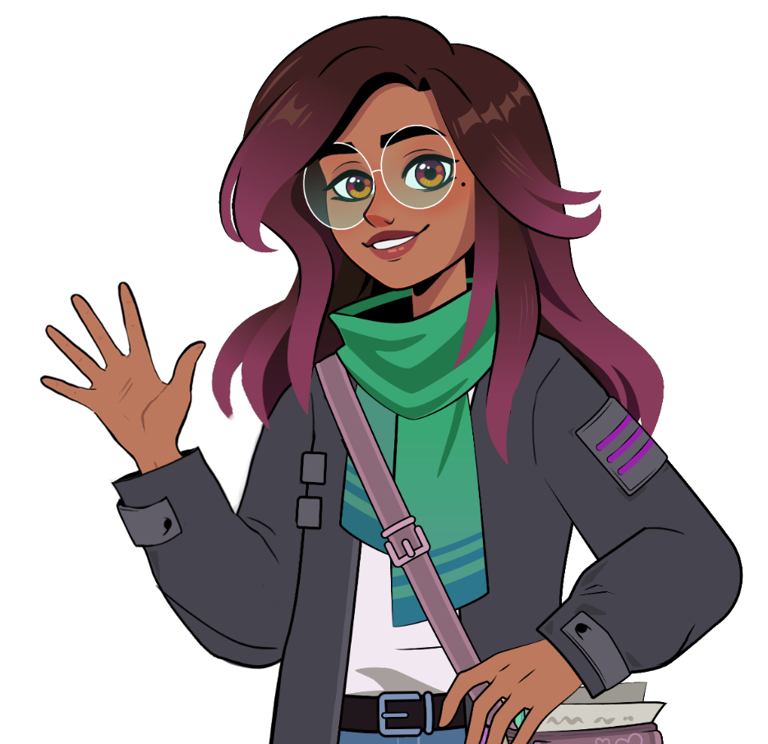
Introducing Reading Assistant
Notes:
Assess Poster: https://explore.amiralearning.com/hubfs/resource/Assess_K2_Poster.pdf

Slide 2
Contents
How to Use this Deck
Get tips for preparing, presenting, and personalizing the lessons.
Lesson 1: Getting Started: Meet Amira
Show students how the benchmark works and why Amira needs to hear them.
Lesson 2: Practicing with Amira
Teach students how to retell a story in their own words after listening carefully.
Lesson 3: Tips for Success
Teach students best practices for reading with Amira.

Slide 3
How to Use
This Deck
Before Presenting
Preview all slides: Read through the full presentation to get familiar with the lesson flow and student-facing content.
Watch model videos: Play the model video and follow the script to practice key points.
During the Lesson
Click through and read aloud: Read the slides aloud to students, or click the audio icon to hear Amira narrate each one.
Ask questions: Use the questions embedded in the slides to prompt discussion and reflection.
Model behaviors: Show students what successful reading with Amira looks and sounds like.

Slide 4
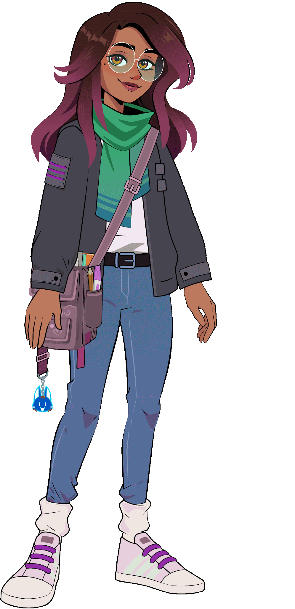
Lesson 1: Meet Amira

Slide 5
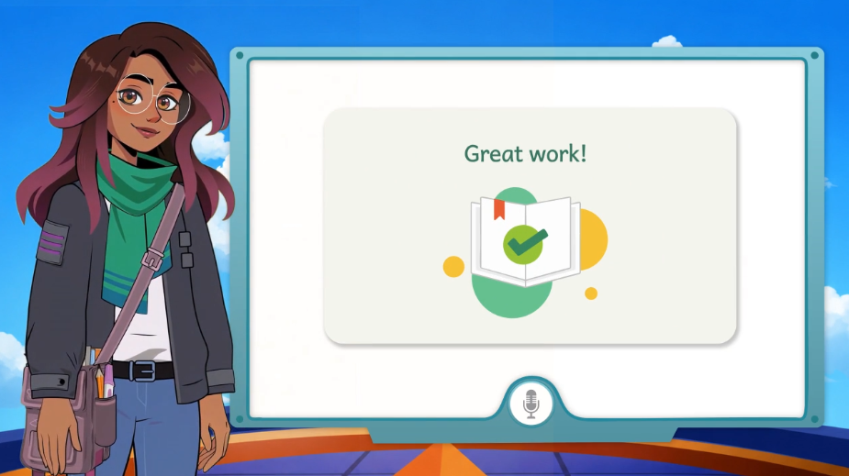
Notes:
https://vimeo.com/amiralearning/k2-a1

Slide 6
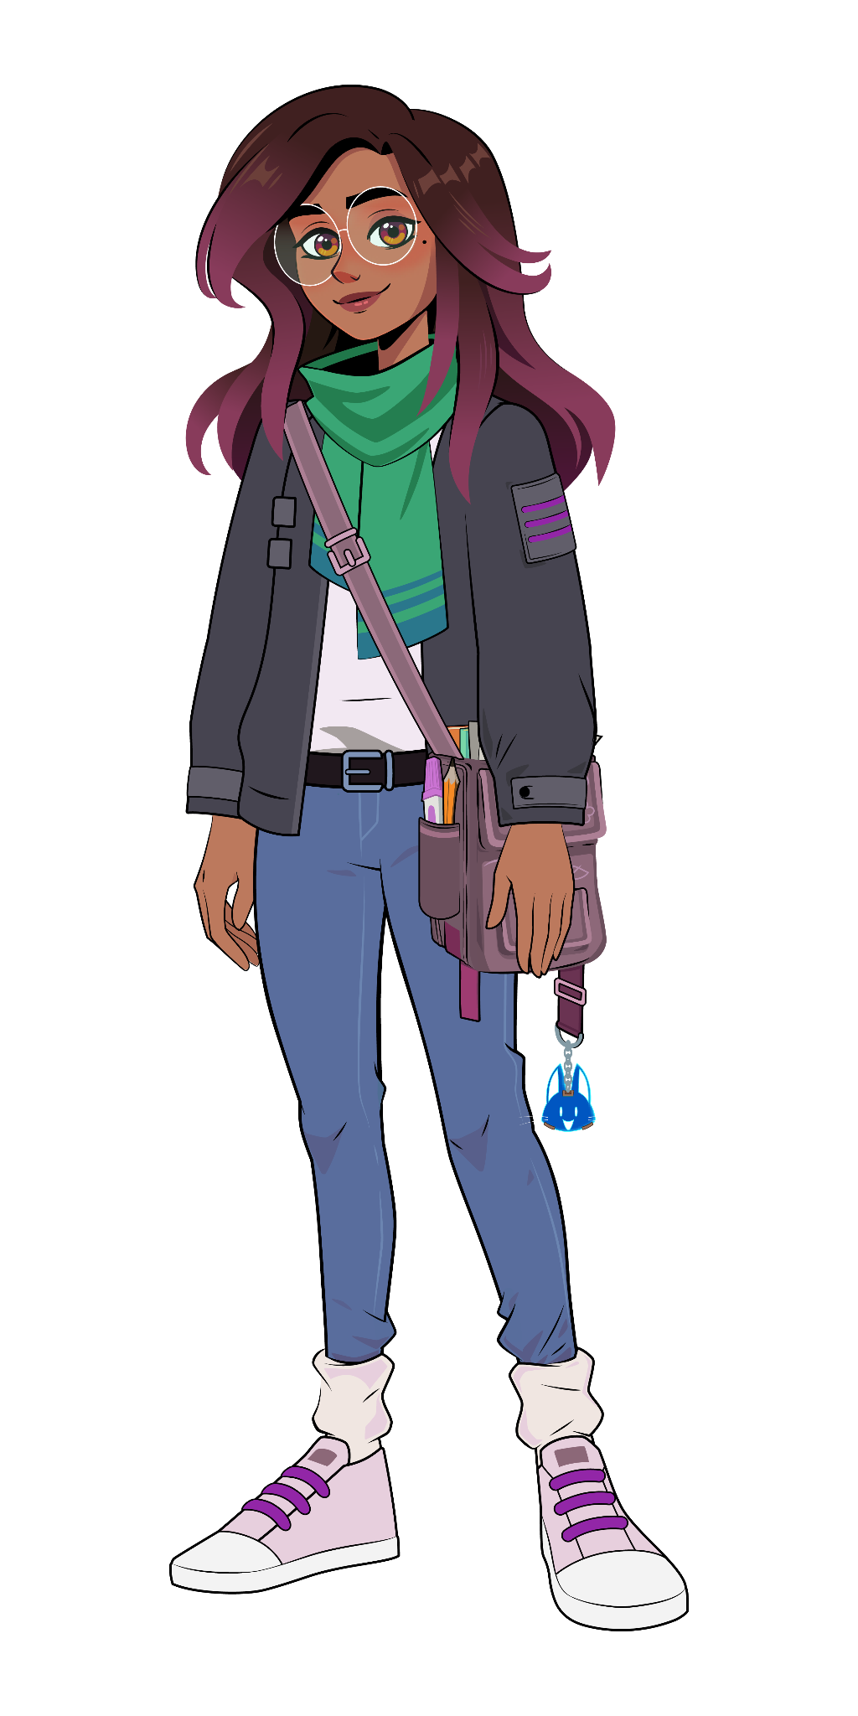

Lesson 1:
Check for understanding:
What should you wait for before you begin reading or speaking?
What should you do if a part feels tricky?
Think deeper:
Why is it important to try your best, even when something feels hard?

Slide 7
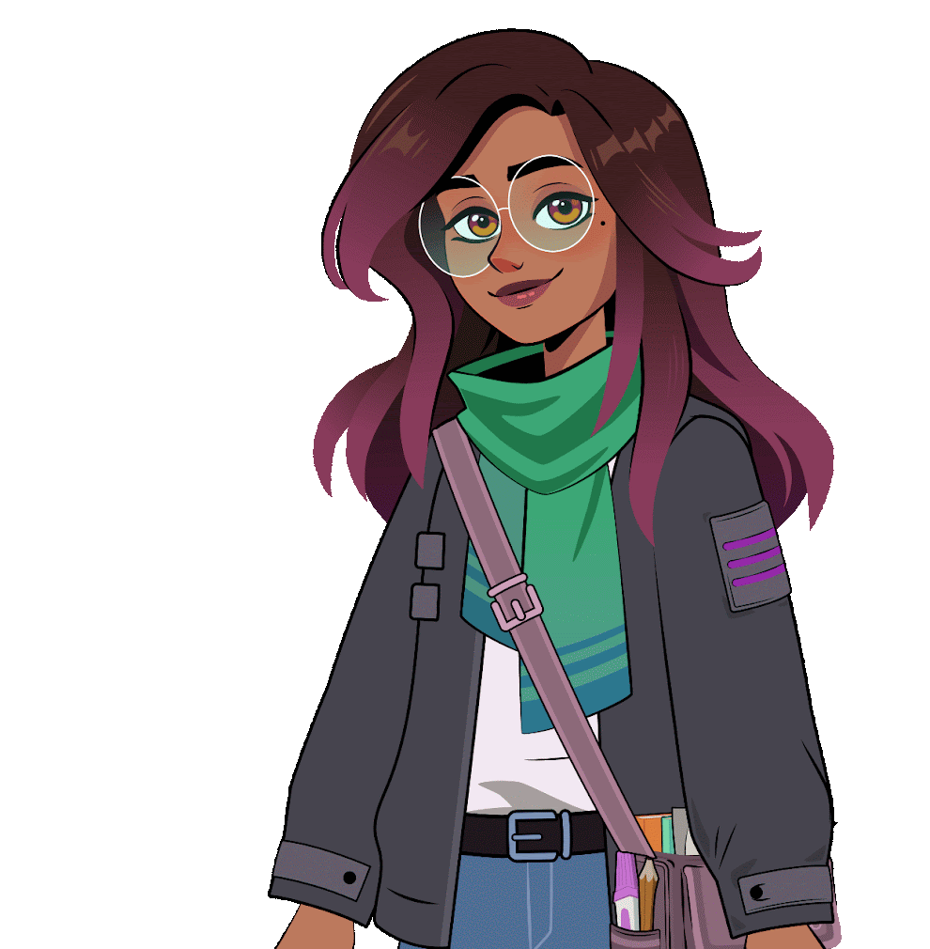
Lesson 2:
Practicing with
Amira

Slide 8
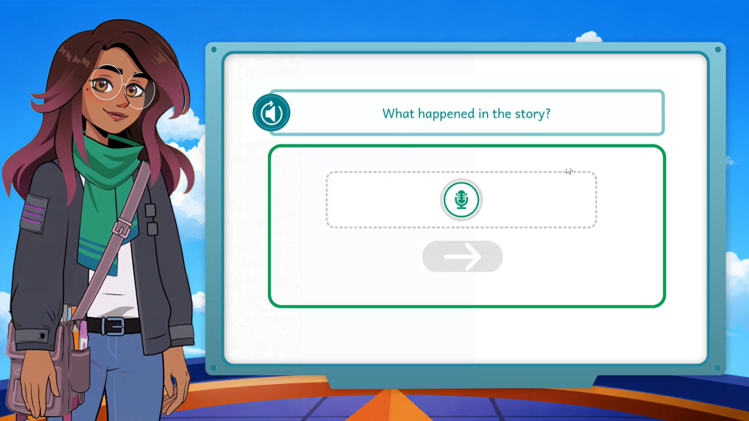
Notes:
https://vimeo.com/amiralearning/k2-a2
NOTE: The story featured in Lesson 2 was created specifically for this lesson and will not appear in the ISIP assessment.

Slide 9
Lesson 2:
The Tiny Dragon
Who is the story about?
Where does the story take place?
What happened first, next and last?
What other details are important to the story?

Slide 10
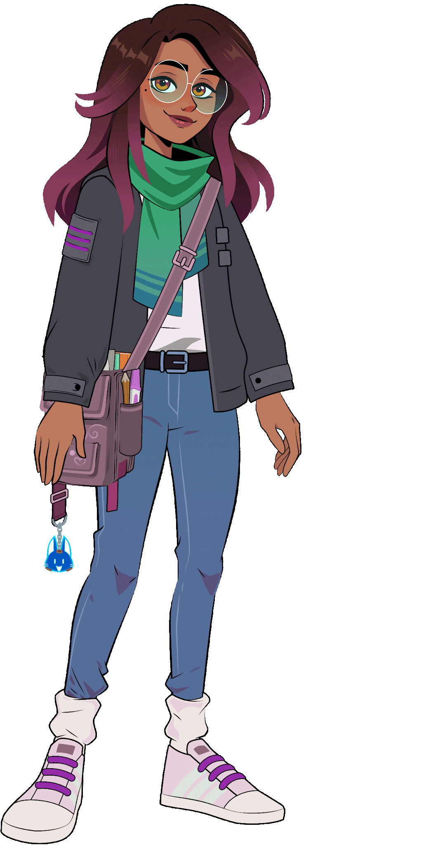
Lesson 3:
Tips for
Success

Slide 11
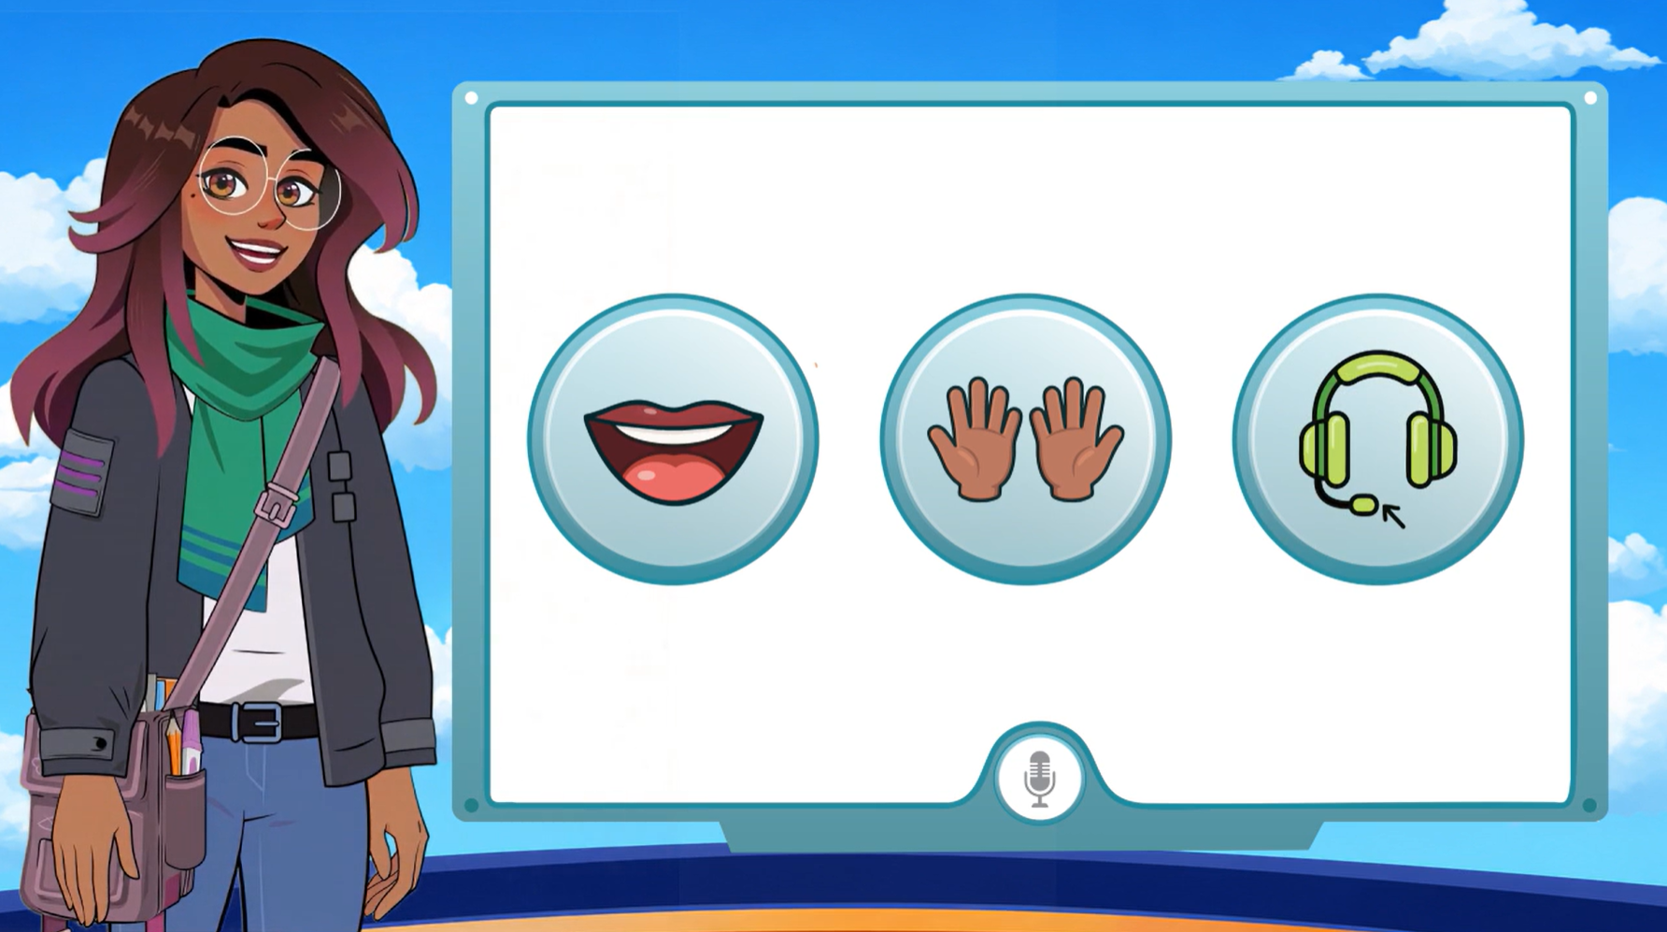
Notes:
https://vimeo.com/amiralearning/gs-35-2
Corresponding Poster

Slide 12
Lesson 3:
What should you keep in mind when reading to Amira?
Why is it important for Amira to hear you clearly?

Slide 13
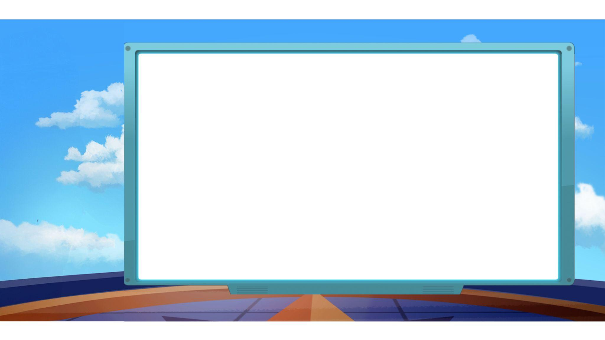
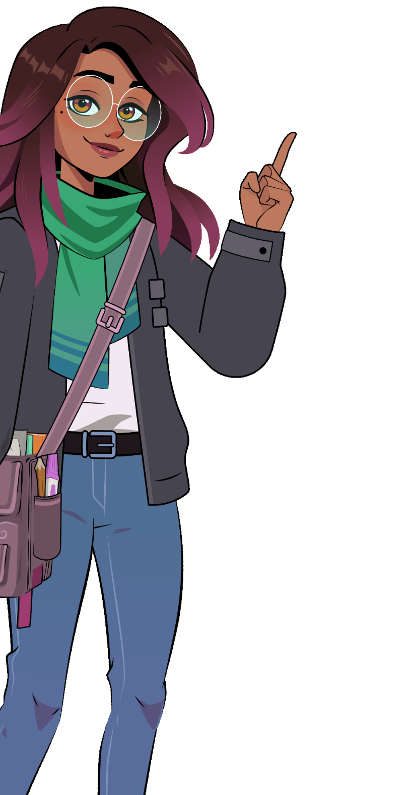
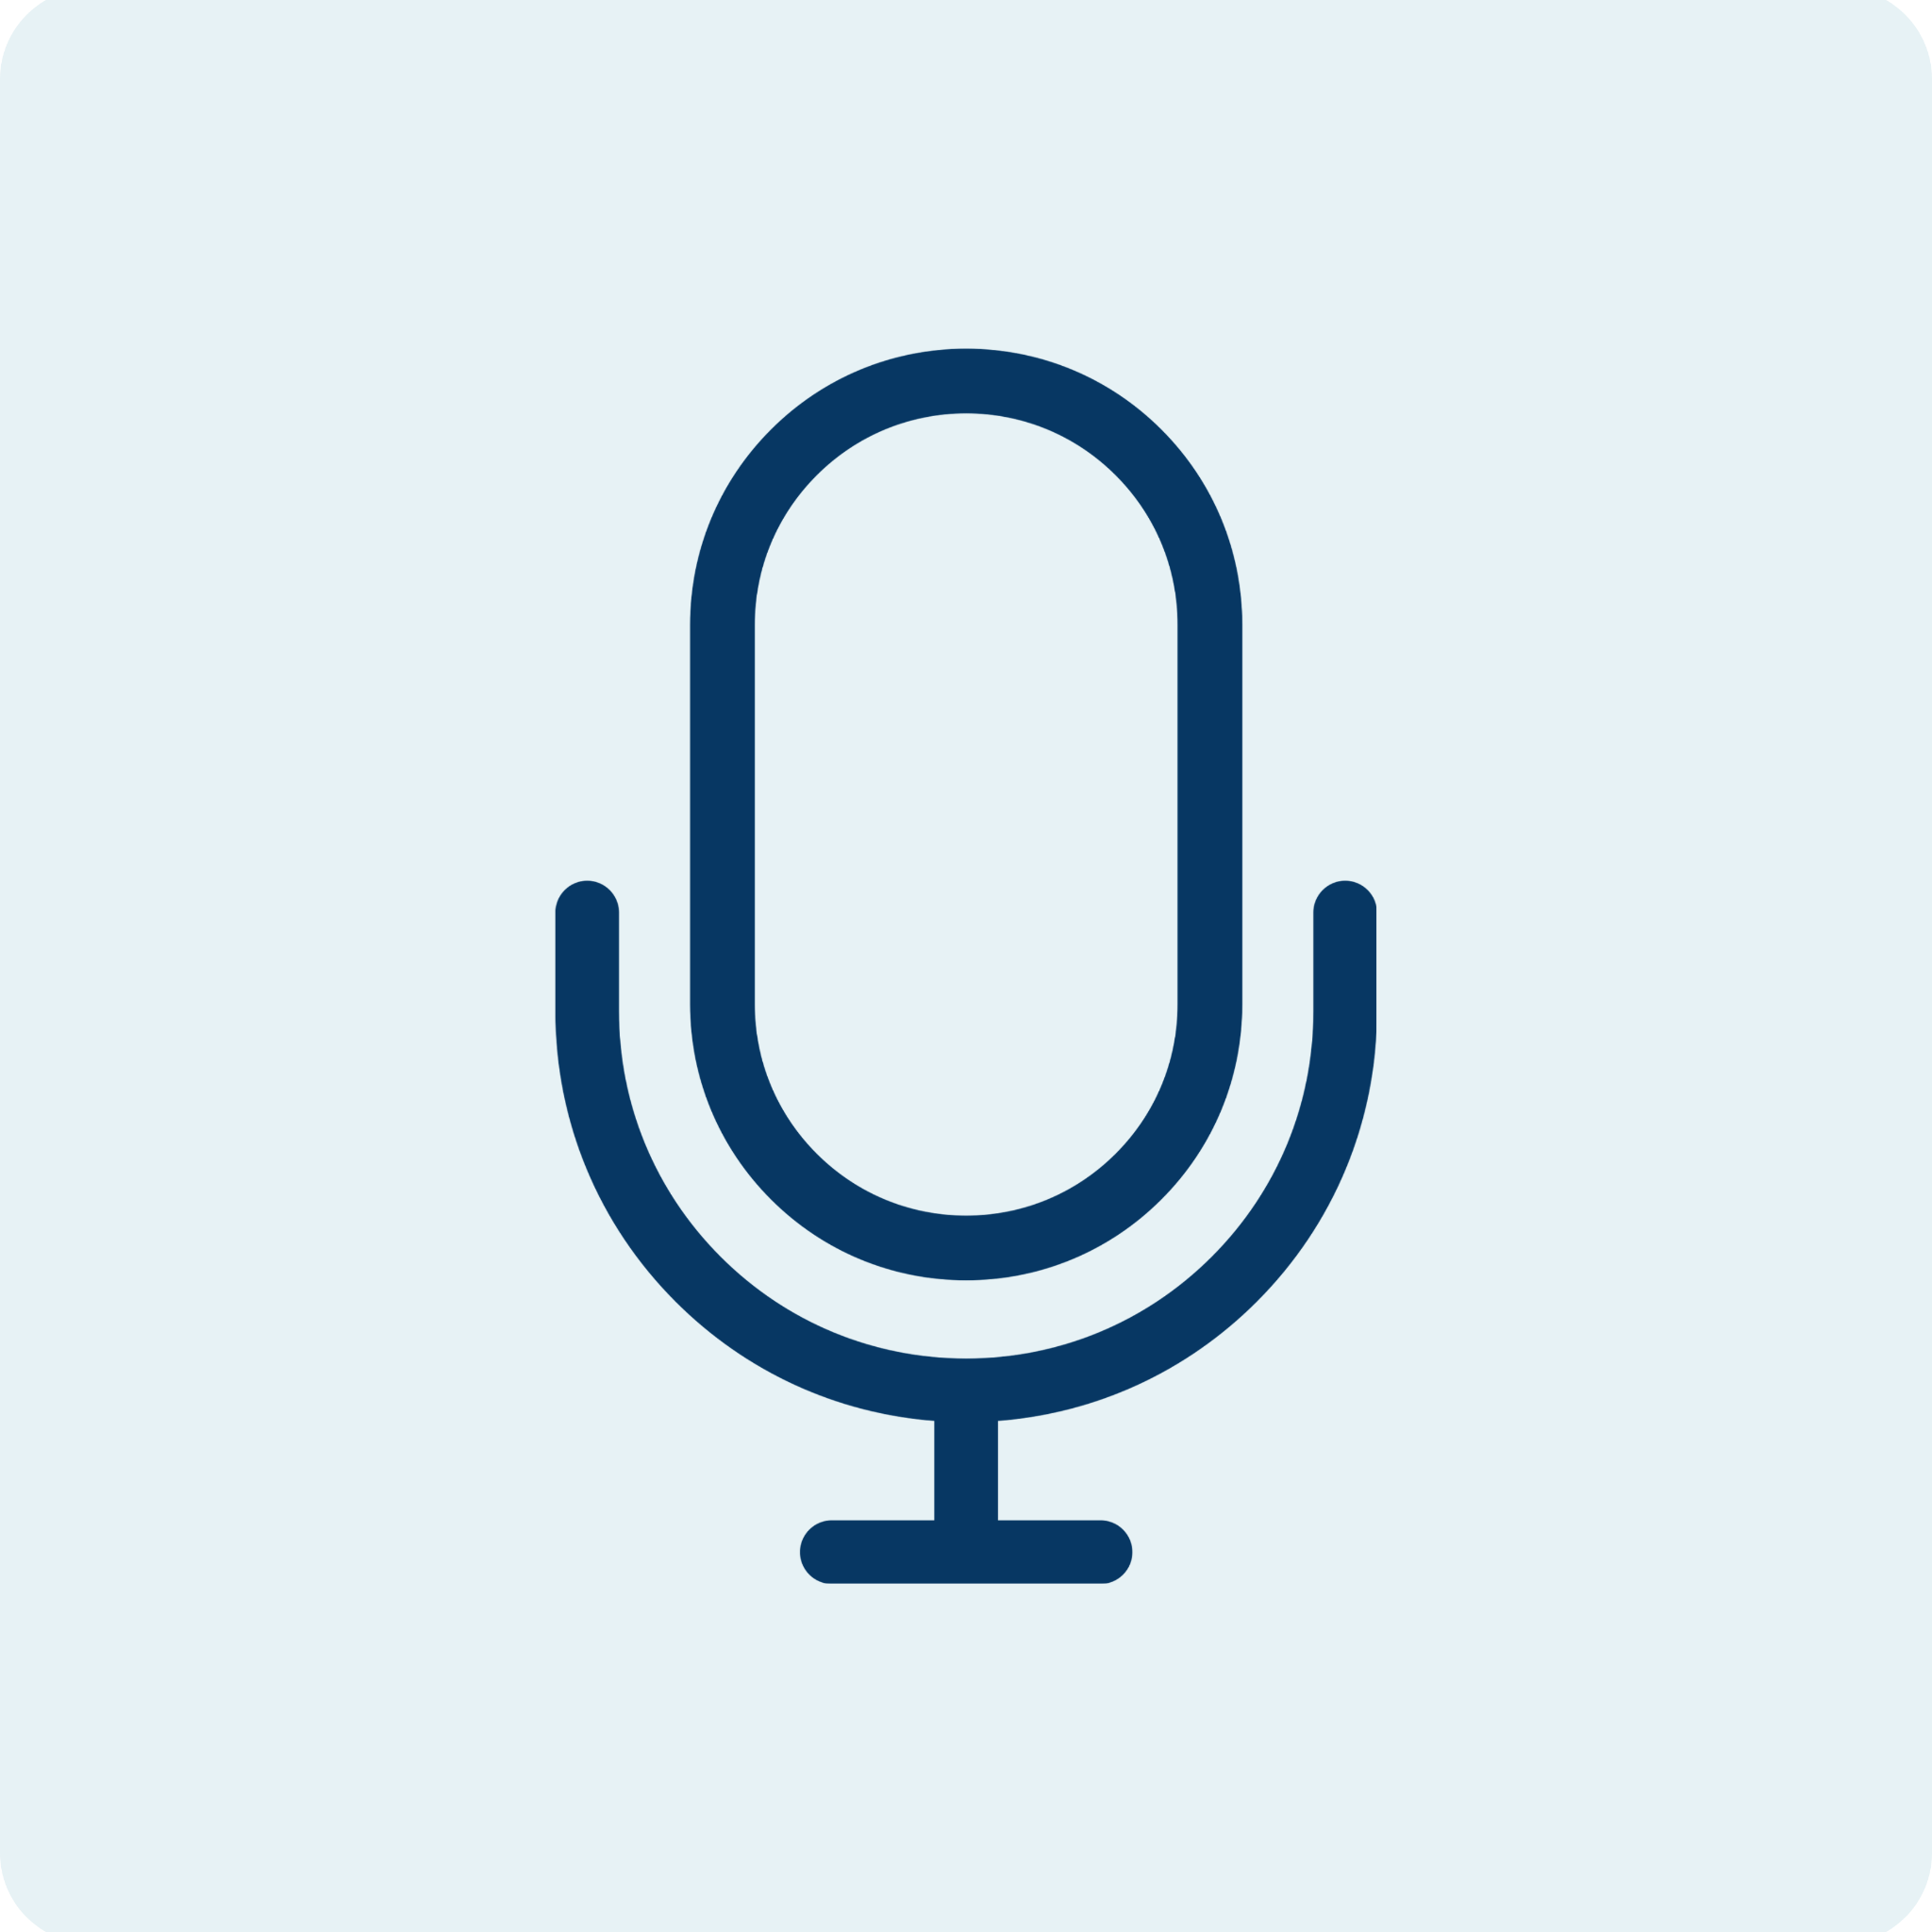



Remember:
You rock! We’re going to have so much fun together.
Let’s get this reading party started!
Mic on.
Green means go.
Let your strongest reading show.
Notes:
Read the slide aloud or click the audio icon to hear Amira read it.

Slide 14
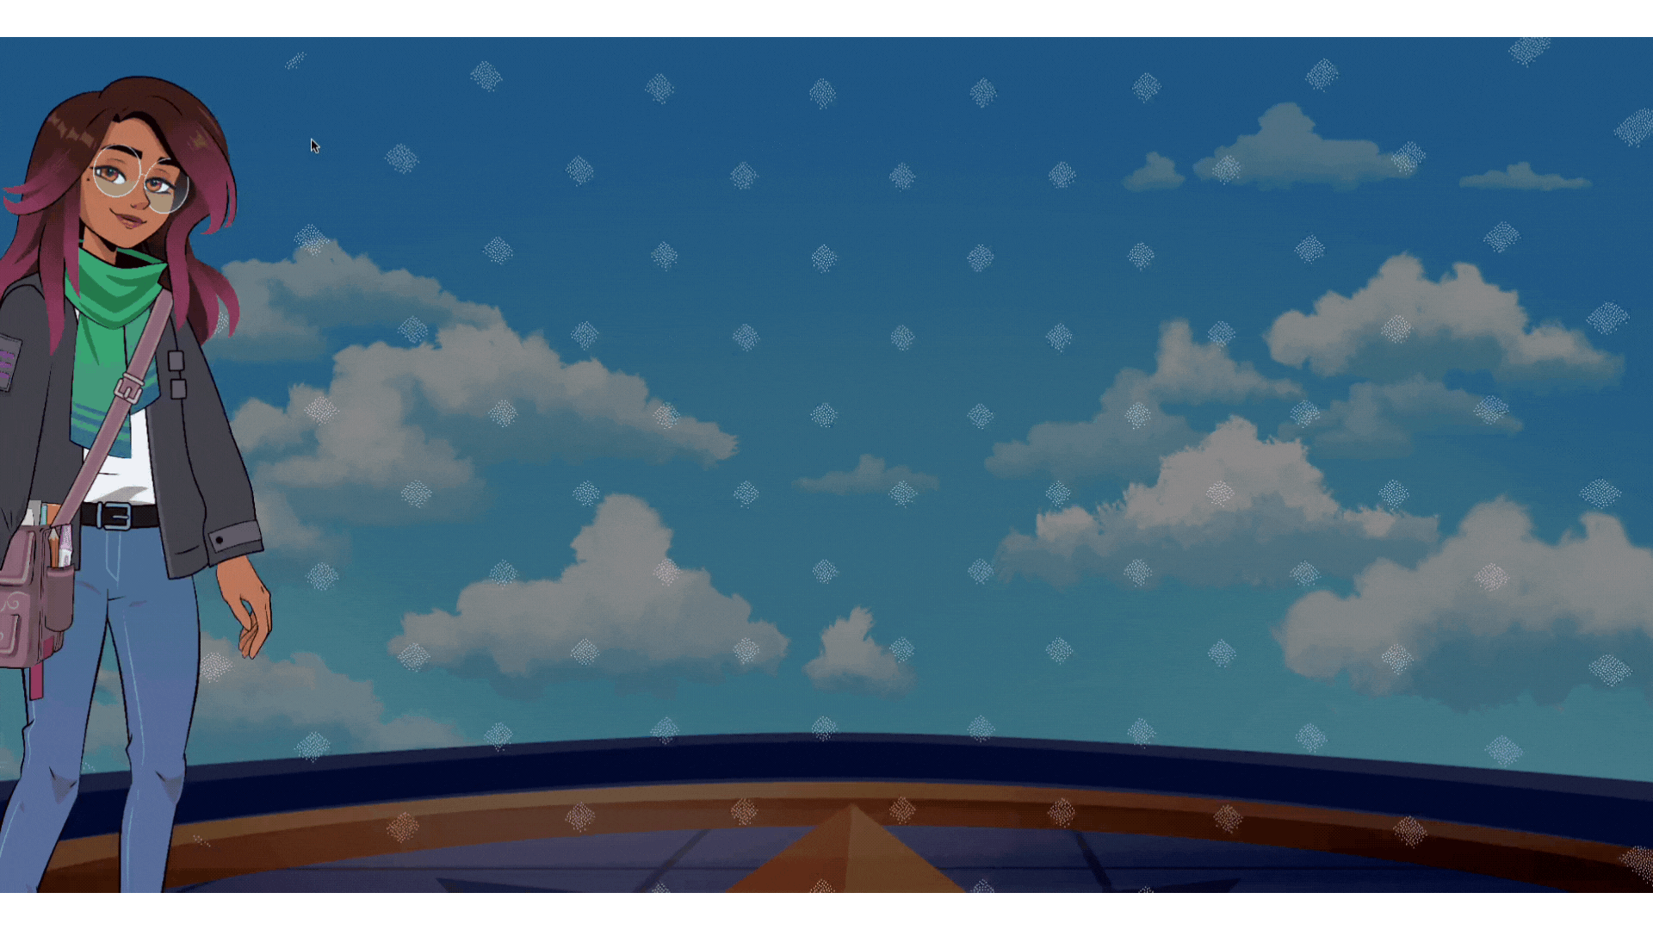
Notes:
Take a dance break!

